Slide 1
ECHA Course on Artificial Intelligence for Chemical Risk Assessment Lecture 3; Foundation Models Panagiotis (Panos) Karamertzanis, PhD; Michael Liem, PhD; (Marc Teunis, PhD;) Coert van Gemeren, PhD
Notes:
## Theory 1: Principles of Machine Learning
**(100 min)**
- **Principles of Machine Learning**
Machine learning involves creating algorithms that enable computers to learn from data and make predictions.
In toxicology, machine learning can be used to predict the toxicity of chemical compounds by analyzing patterns
in biological data. For example, models can be trained to identify potential carcinogens based on historical data.
- **What is AI, and which flavours? History of AI**
AI encompasses various technologies, including machine learning, that simulate human intelligence.
In chemical hazard assessment, AI can automate the analysis of large datasets to identify hazardous chemicals.
The history of AI in this field includes the development of expert systems that assist in regulatory
compliance and risk assessment.
- **Architecture - algorithm? Regression based vs neural network**
Regression models, such as logistic regression, are used to predict binary outcomes like
the presence or absence of a toxic effect. Neural networks, on the other hand, can model complex relationships
in data, such as predicting the interaction effects of multiple chemicals on human health.
- **What is a neural network, building blocks**
Neural networks consist of interconnected neurons that process data in layers. In toxicology, neural
networks can be used to model dose-response relationships, where the input layer represents chemical
concentrations and the output layer predicts biological responses.
- **Embedding; from data to numbers, examples, tensors, vectors**
Embedding techniques convert categorical data, such as chemical names, into numerical vectors that
can be processed by machine learning models. In chemical hazard assessment, embeddings can represent
molecular structures, allowing models to learn from structural similarities between compounds.
- **Features, feature space (materials from AIRA course)**
Features in machine learning are the input variables used to make predictions. In toxicology, features
might include molecular weight, solubility, and other physicochemical properties. The feature space is the
multidimensional space where these features are represented, and effective feature selection is crucial for
accurate predictions.
- **Validation, cross-validation, leave-one-out, metrics of performance**
Validation techniques ensure the reliability of machine learning models. In chemical hazard assessment,
cross-validation can be used to evaluate models that predict the environmental impact of chemicals. Performance
metrics such as sensitivity and specificity are important for assessing model accuracy in identifying hazardous
substances.
- **Which models are used?**
Various models are used in machine learning, including decision trees, which can classify chemicals based
on their hazard potential, and support vector machines, which can separate toxic from non-toxic compounds.
Deep learning models, such as convolutional neural networks, are increasingly used for image-based toxicity
screening.

Slide 2
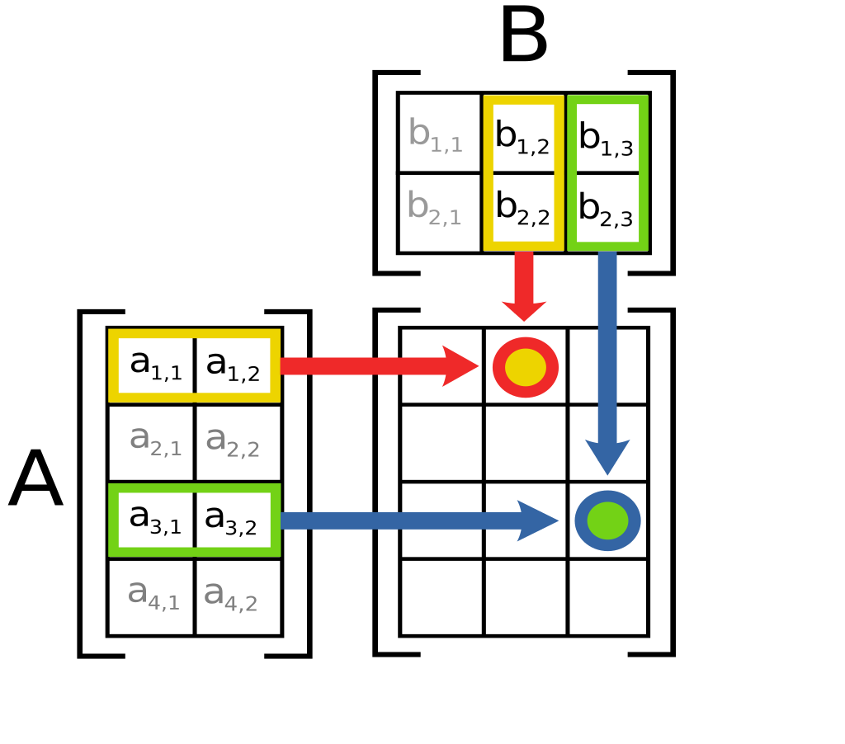
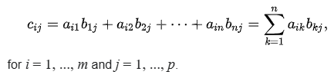
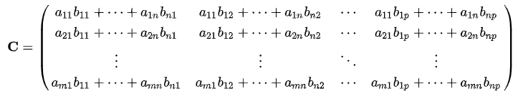
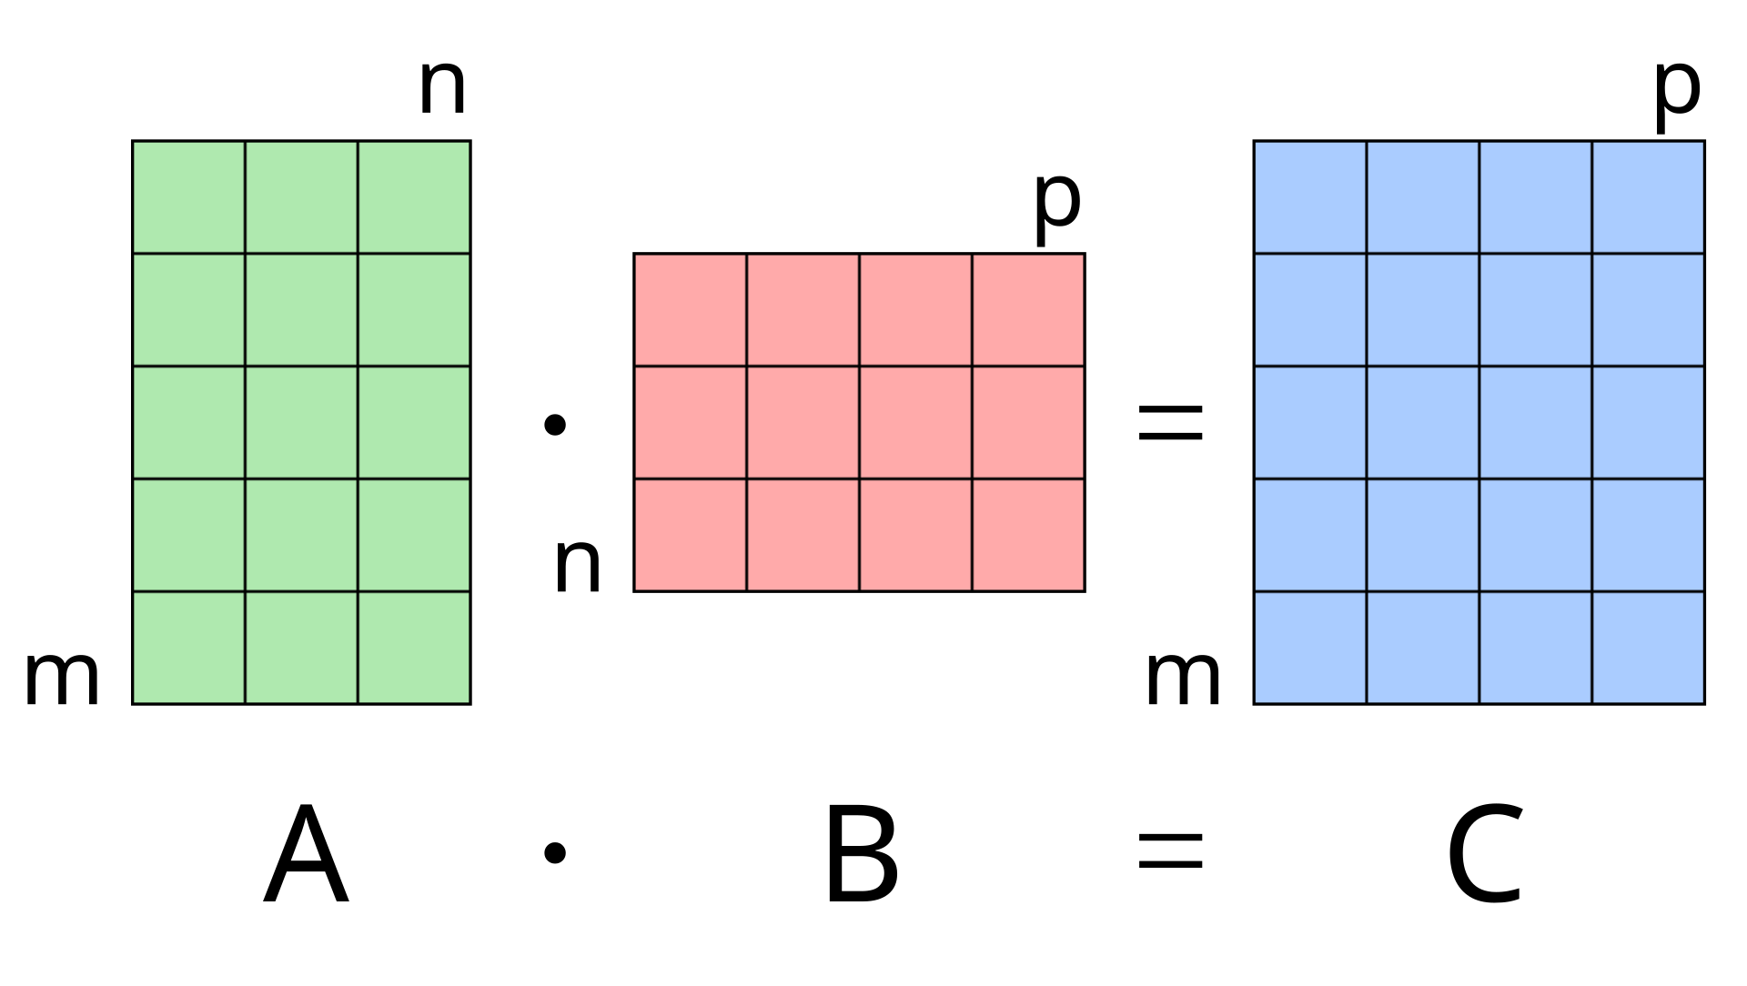
Matrix multiplication: C = A • B
n
m
n
p

Slide 3

Lecture 3; Foundation Models
Coert van Gemeren, PhD,
Research scientist,
University of Applied Sciences, Utrecht
The Netherlands
Marc A.T. Teunis, PhD,
Associate professor,

Slide 4
Lecture 3 – Contents
What are foundation models?
Training and
Latent space
Examples
Thinks move fast
AI dilemmas

Slide 5
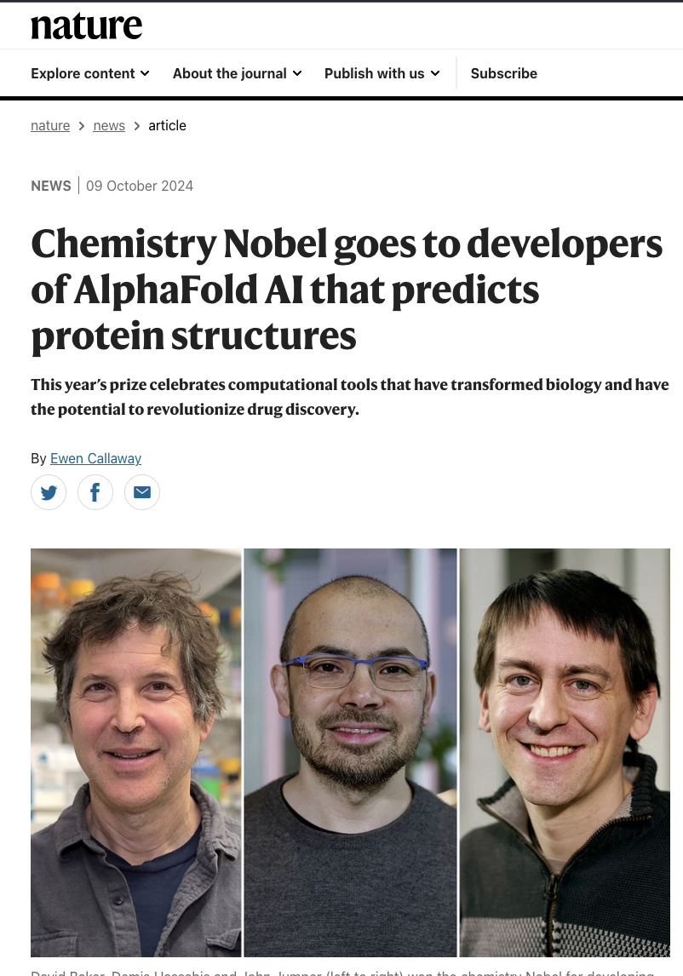
Nobel prize (Chemistry), October 2024
From analysing protein structures with X-ray crystallography and later nuclear magnetic resonance (NMR) to predicting the 3D structure based on 1D sequence with AI

Slide 6
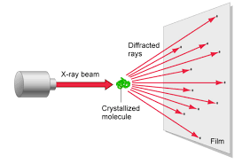
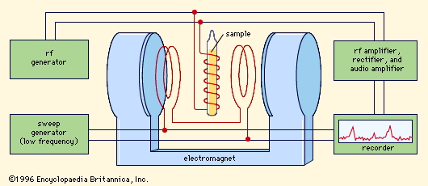
Analysing protein structures
X-ray chrystalography
Nuclear Magnetic Resonance (NMR)

Slide 7
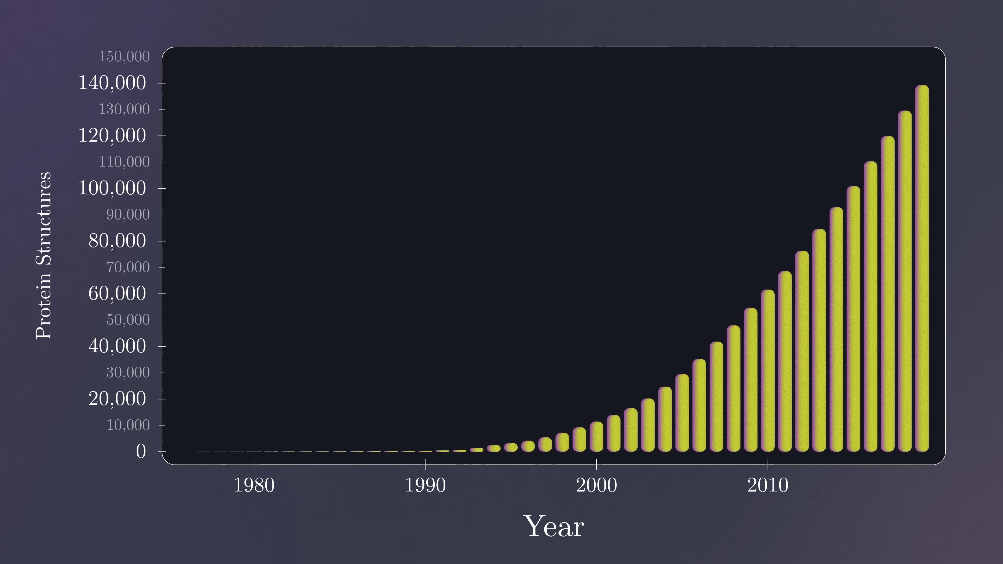

Slide 8
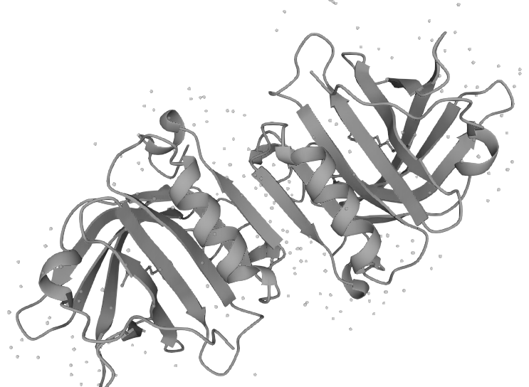

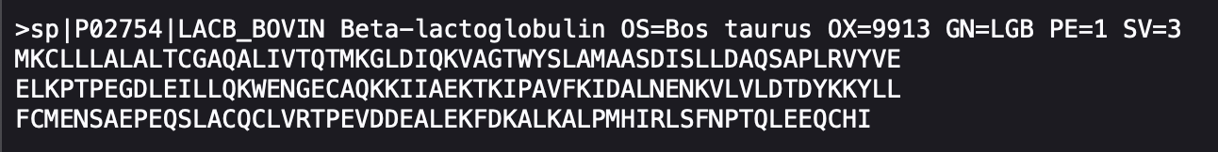
P02754 · LACB_BOVIN

Slide 9
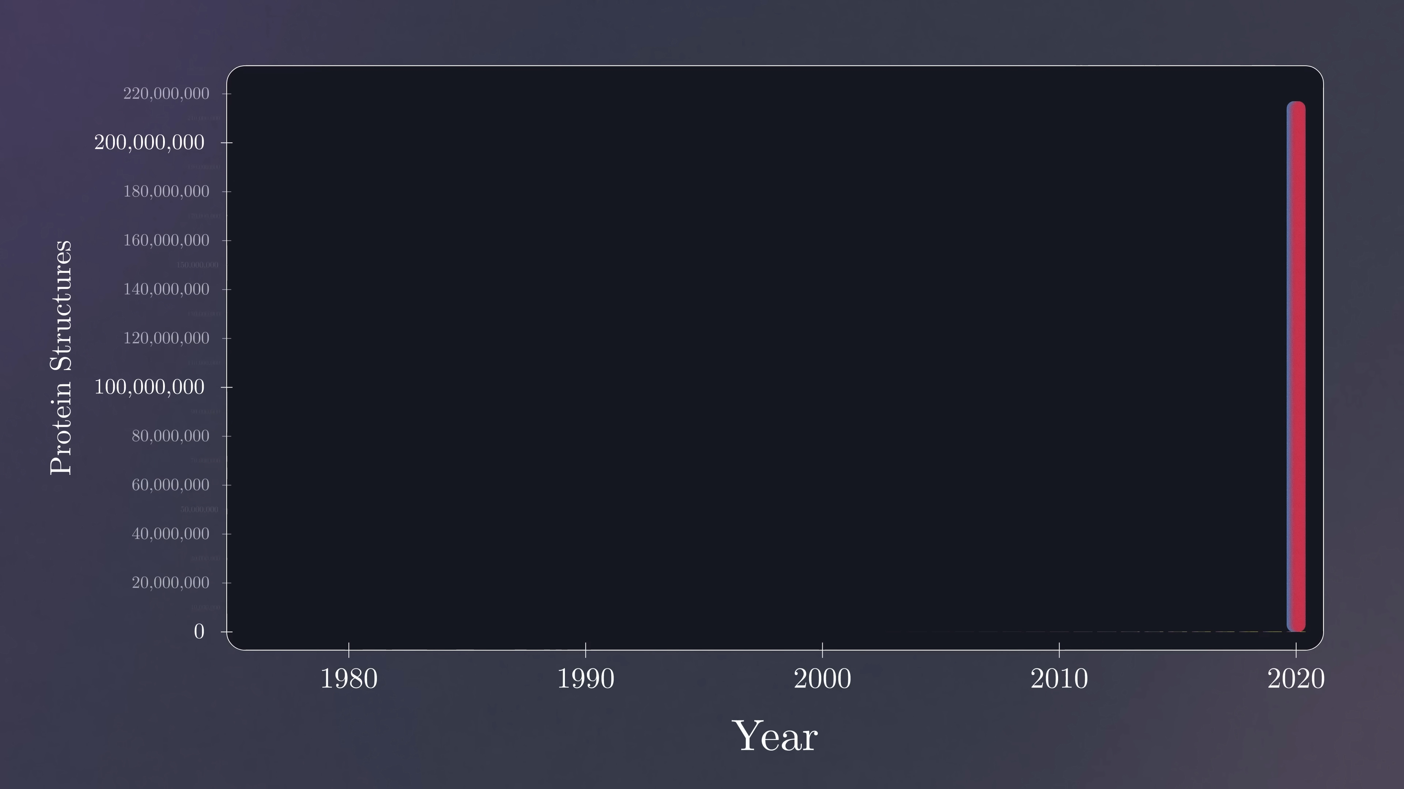
Veritasium - The Most Useful Thing AI Has Ever Done
https://www.youtube.com/watch?v=P_fHJIYENdI

Slide 10
Find sequence for B. taurus Betalactoglobulin
Database
UniProt (https://www.uniprot.org/)
Run prediction for 3D in AlphaFold Server (https://alphafoldserver.com/)

Slide 11

What are foundation models?

Slide 12
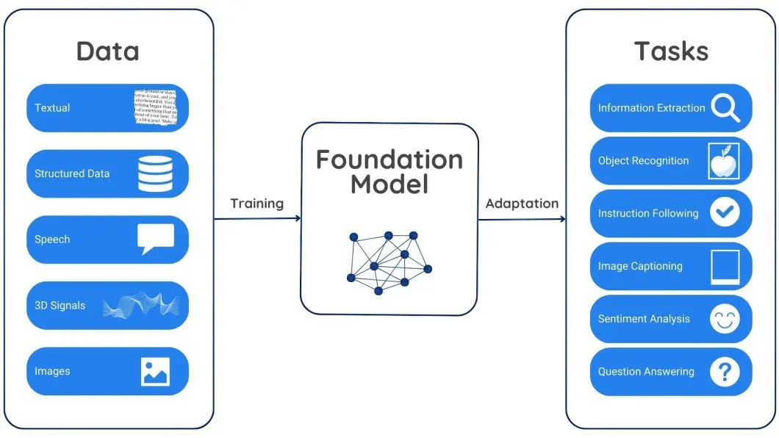
Foundation model definition
https://viso.ai/deep-learning/foundation-models/
Notes:
How Do Foundation Models Work?
Foundation models work on self-supervised learning, which allows them to learn meaningful representations from the input data without relying on explicit labels or annotations. They are pre-trained on huge datasets. During this stage, the model predicts missing parts, fixes corrupted data, or finds connections between different data types. This teaches the model inherent patterns and relationships within the data.
Pre-training equips the model with a strong understanding of the underlying data structure and meaning. This learned knowledge becomes a foundation for specific tasks performed by the model. By fine-tuning smaller, specific datasets, the model can be adapted for various tasks.
For example, a foundation model trained on textual data might understand word relationships, sentence formations, and diverse writing styles. This foundational understanding enables the model to carry out tasks like generating text, translating content, and answering questions after fine-tuning.

Slide 13
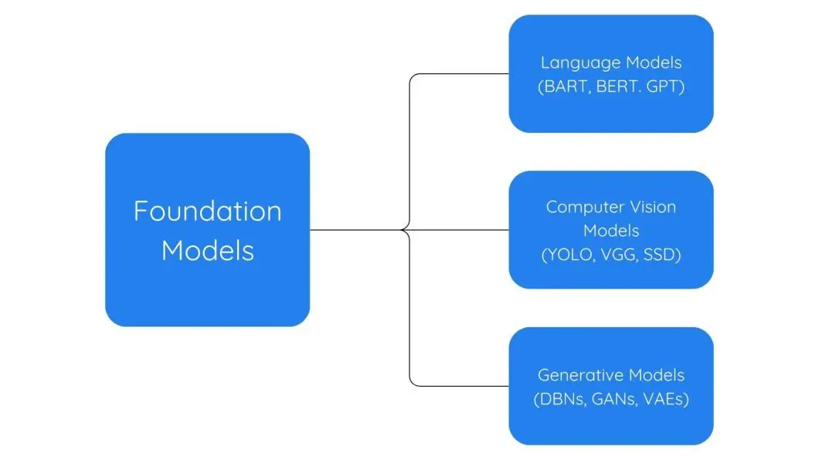
Examples of Foundation Models

Slide 14
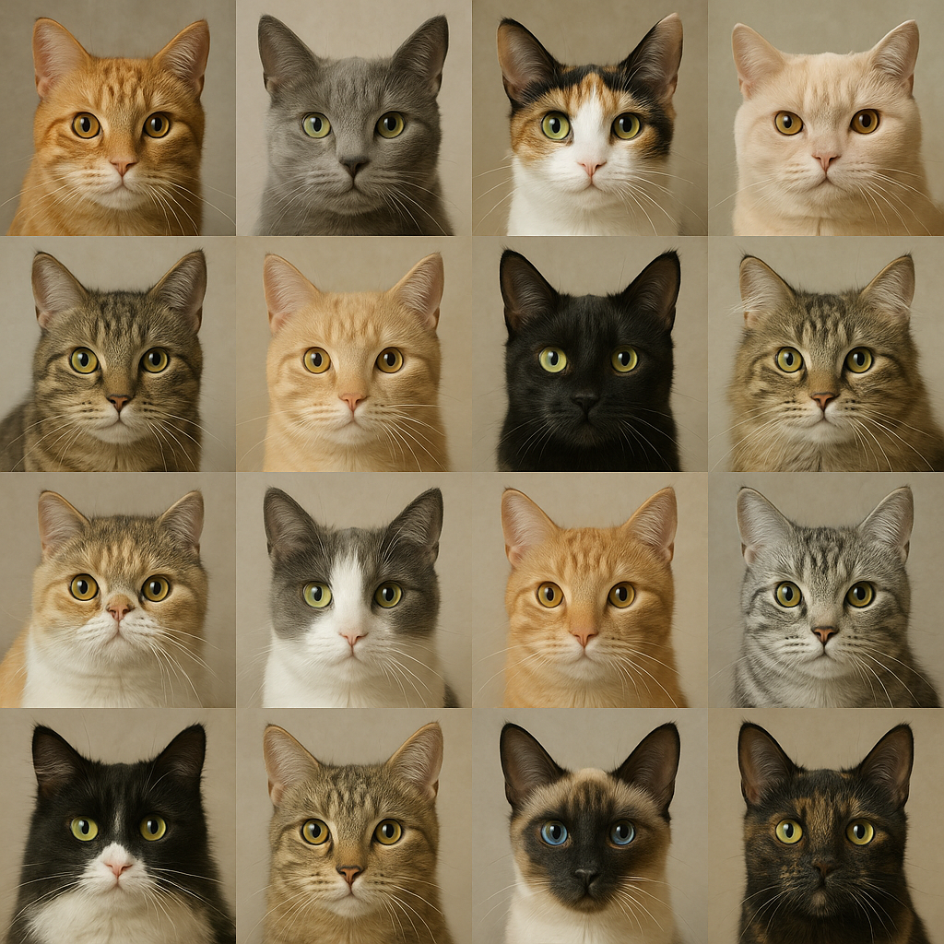
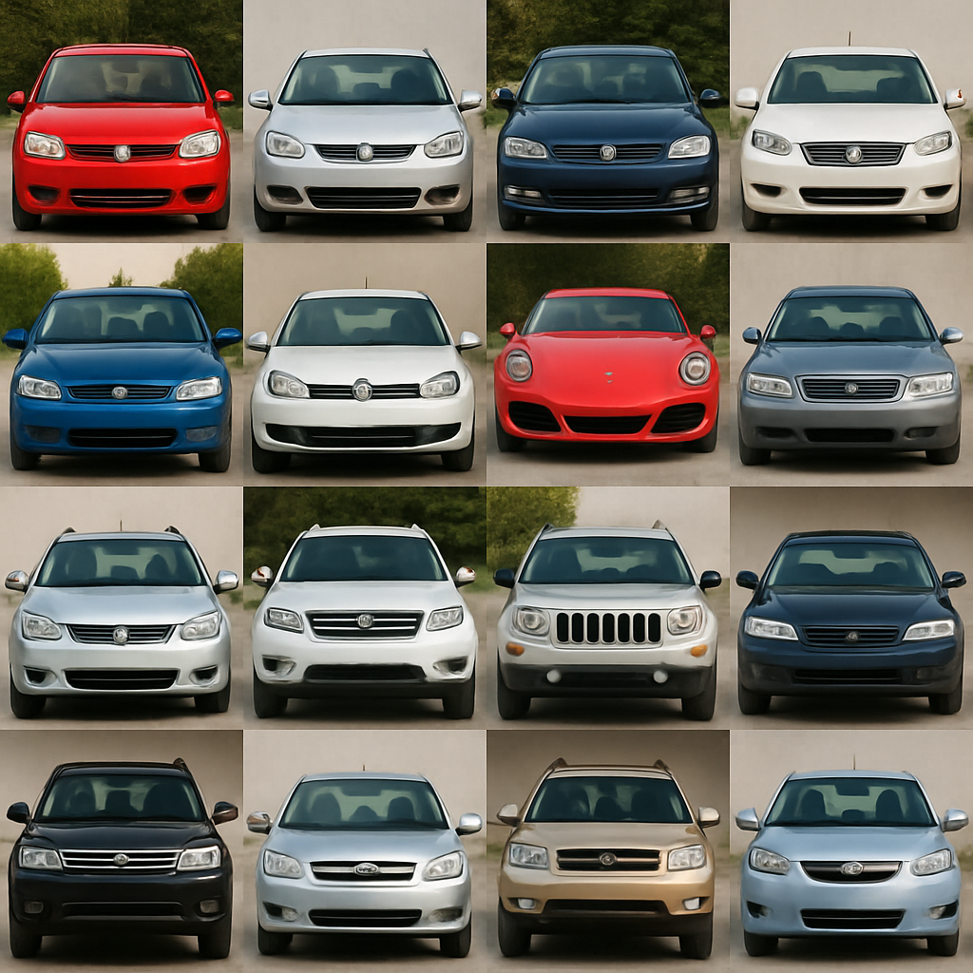
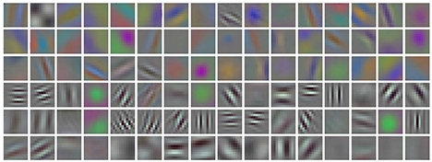
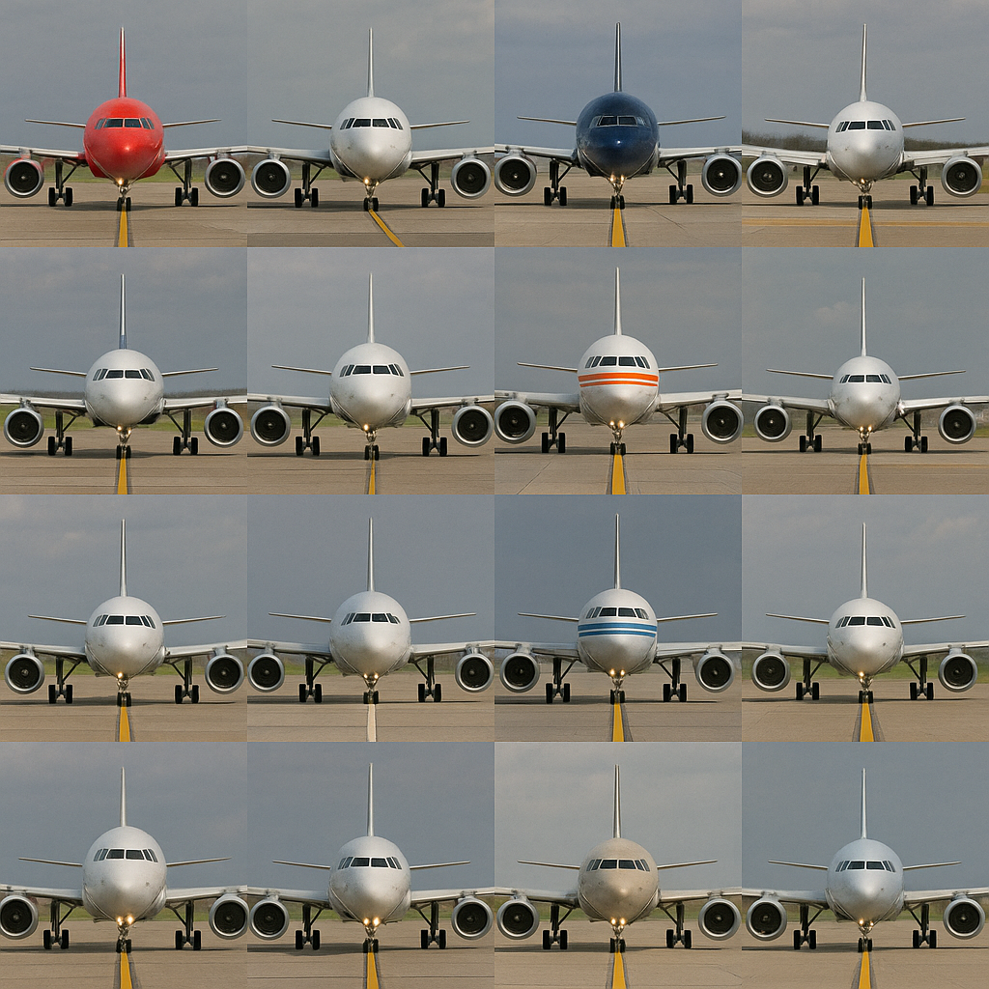
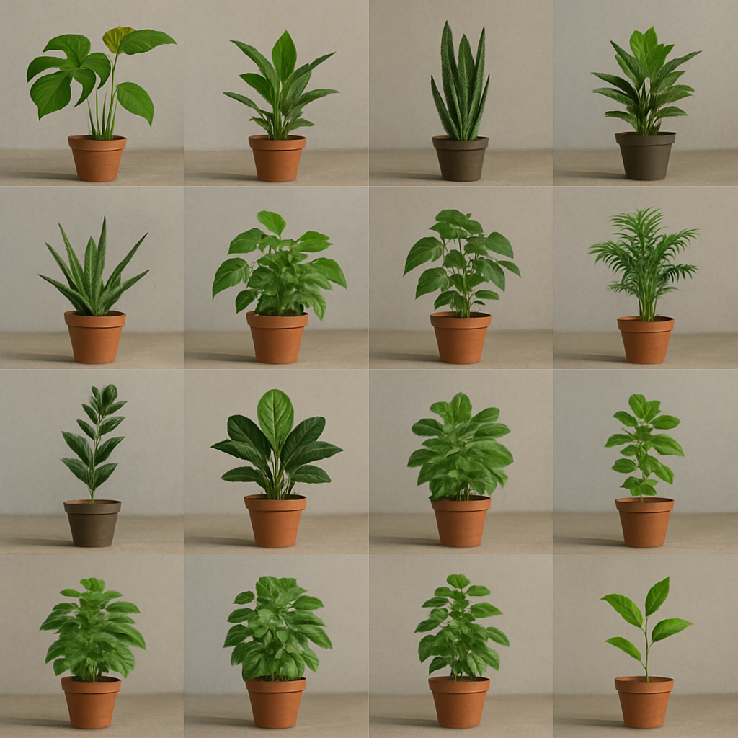
Generic filters

Slide 15
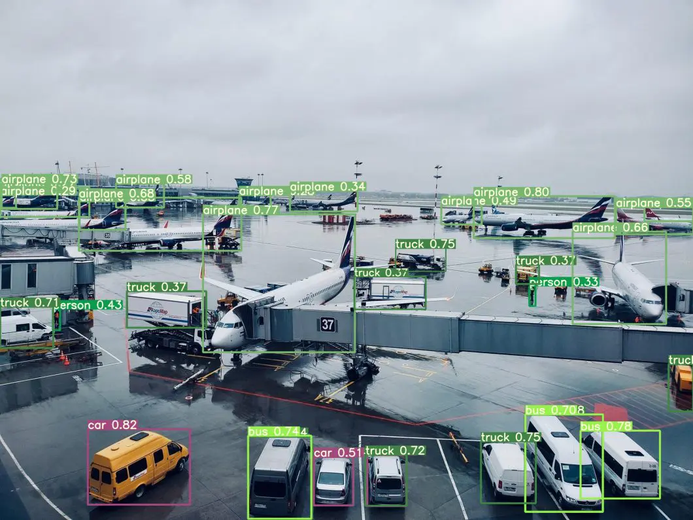
YOLO (You-Only-Look-Once)
https://www.v7labs.com/blog/yolo-object-detection

Slide 16

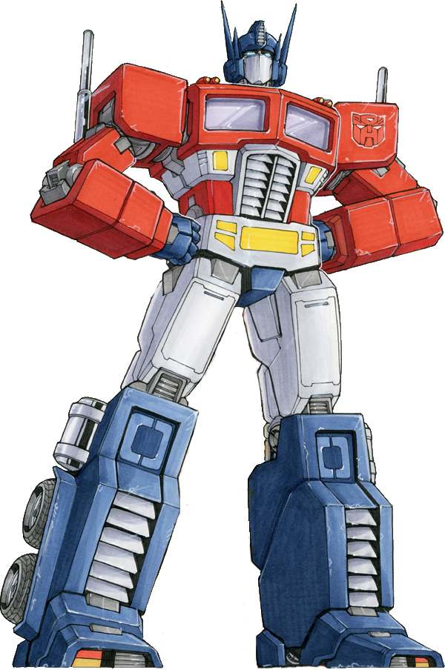
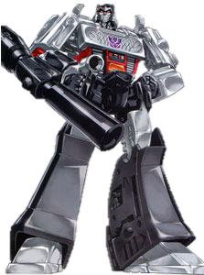
Generative Pre-Trained Transformer
Robots depicted are Optimus Prime and Megatron, Hasbro Transformers

Slide 17

How to train your … LLM
Image generated with help of GPT-4o, January, 2025

Slide 18
What is needed to build and LLM?
Much Training data
+
Deep Learning Architecture
+
Training process
LLM =
Everything is vectors!

Slide 19



Training data
Truly large volumes of text, conversations, books articles, …
Training data
1 Gb text = ~178 M words
GPT-3 was trained on 45 Tb text data
45,000 * 178,000,000 =
~8 Billion (*10¹²) words
GPT-4 was trained on
possibly Petabytes (*10¹⁵)
of text data

Slide 20
Training process

Slide 21

The cow is in the car
Training process
Self-supervised learning
x = The cow is in ther car vs
y = The cow is in the meadow
large numeric difference between x and y adjust weigths and biases & try again ->
reduce ‘Cost’ to minimum

Slide 22
The cow is in the …
Training process
Self Supervised Learning
The cow is in the meadow, contentedly munching on the dew-soaked grass, when the farmer notices something unusual. Early in the morning, as the first rays of sunlight pierce through the mist, he spots a shimmering circle hovering above the ground. Curious and slightly apprehensive, he approaches the anomaly, realizing it's a portal to another dimension. As he steps closer, the portal pulses with a brilliant light, and ethereal whispers seem to invite him in. Overwhelmed but intrigued, the farmer must decide whether to step through to the unknown or remain in his familiar world with his cows. Text by ChatGPT (GPT-4) – assume this is from a SciFi book

Slide 23
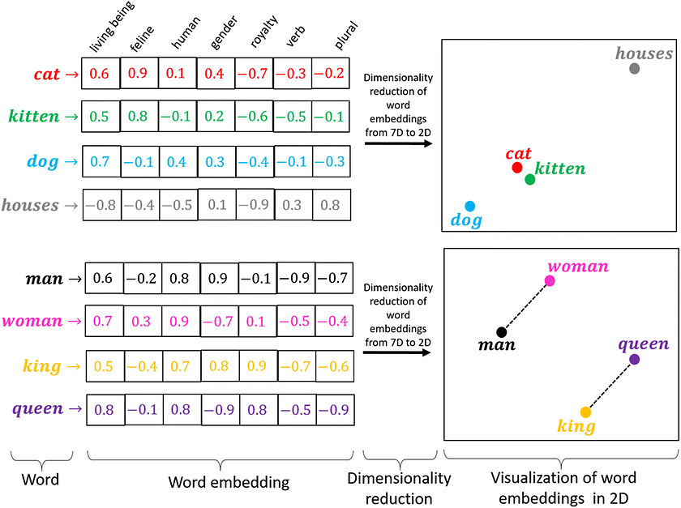
Embeddings

Slide 24
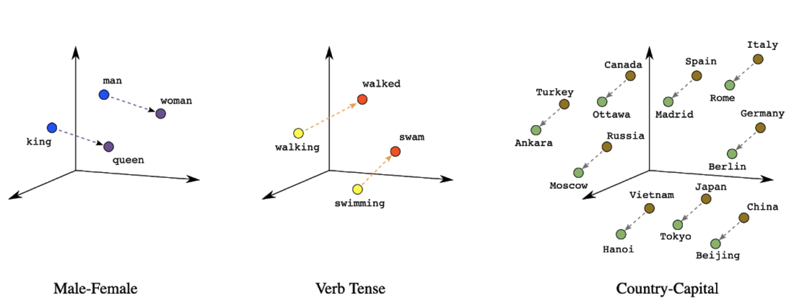
Word embeddings in a vectorized latent space

Slide 25

Language ‘concepts’ representations (high dimensional) data representation
meadow, field, land, yard
weide, veld
farm, boerderij, stal, huis, ferme
zolder, woonkamer, attic, living room
Training process

Slide 26
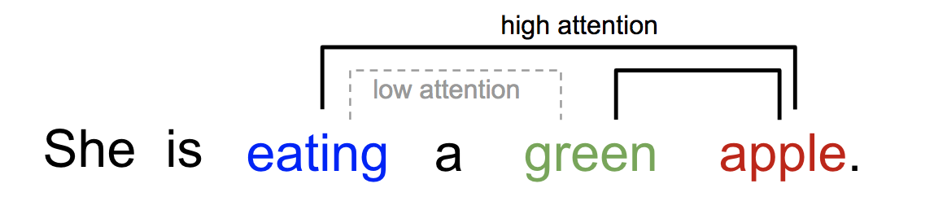
Attention

Slide 27
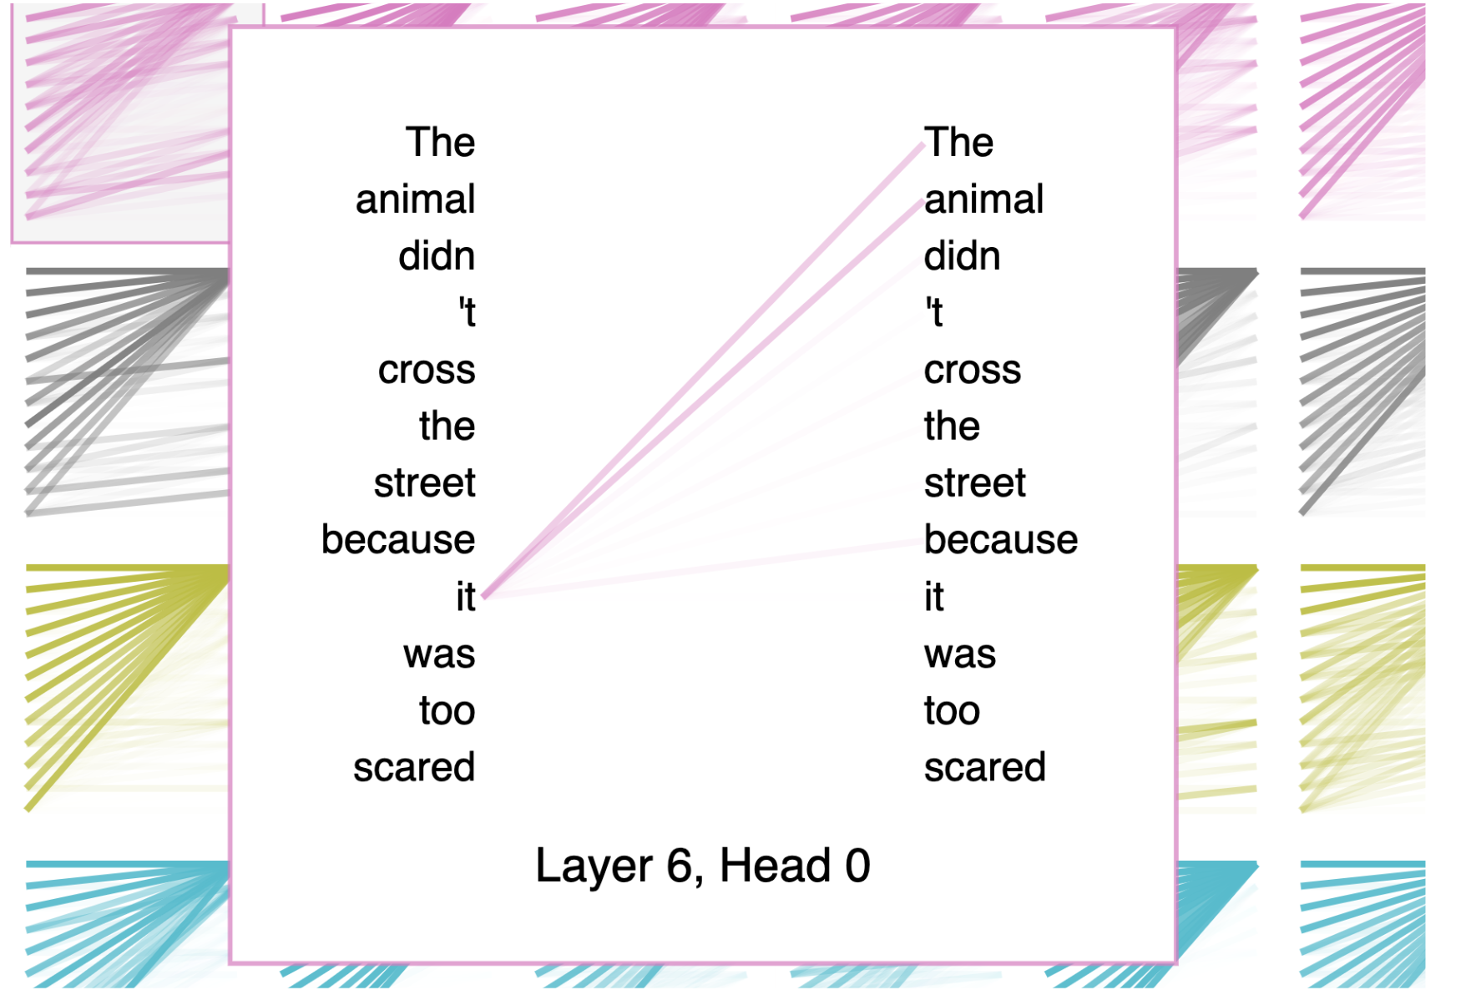
Attention

Slide 28



Training process
The cow is in the meadow
The cow is grazing in the meadow….
RLHF; Reinforcement Learning with Human Feedback,
based on reward.
The model will optimize its ‘reward’

Slide 29
The Curse of dimensionality
As the number of features (dimensions) increases:
Data points become increasingly distant from each other
Models need exponentially more data to generalize well
Many features may be irrelevant or redundant, adding noise
So, in high-dimensional spaces, many algorithms (like k-NN, SVM, etc.) struggle to learn meaningful patterns.

Slide 30
The Curse of dimensionality (in Deep Learning)
Deep Learning mitigates the curse by design:
1. Automatic Feature Learning
Deep networks learn hierarchical representations — from raw data to higher-level features through its layers
This reduces the reliance on raw high-dimensional input (e.g., pixels, words) by compressing useful information in intermediate layers.
2. Parameter Sharing
In models like Convolutional Neural Nets (used for images), filters share weights across space — which drastically reduces the number of parameters even in high-dimensional input like a 256×256 image (65,536 dimensions)
Similarly, transformers use attention mechanisms that capture long-range dependencies efficiently
3. Regularization and Sparsity
Techniques like dropout, batch normalization, L1/L2 regularization, and weight decay prevent overfitting in high-dimensional spaces.
Some layers (e.g., ReLU, sparse activation functions) naturally promote sparse representations, reducing effective dimensionality.
4. Massive Data and Compute
Deep learning is usually deployed with large datasets and high compute power, which helps counteract the curse (where small data in high dimensions is most problematic).

Slide 31
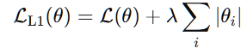
L1 regularization
L1 regularization is a technique used in machine learning and deep learning to prevent overfitting by adding a penalty to the loss function based on the absolute values of the model’s weights.
Formally, for a loss function L(θ), L1 regularization adds a term proportional to the sum of the absolute weights:
λ is a regularization strength hyperparameter.
𝜃_{𝑖} are the model parameters (weights).
Encourages sparsity: it drives some weights to exactly zero, effectively performing feature selection
Commonly used in models where interpretability or feature reduction is important

Slide 32
Foundation models in medical biology and healthcare

Slide 33
Case study
We will look at some foundation models, used in imaging
We will take a closer look at the methods used and the architectures (training paradigms and type of data)
We can then start extrapolating to our own field (chemical safety)
Why imaging: because humans tend to understand pictures above everything else

Slide 34
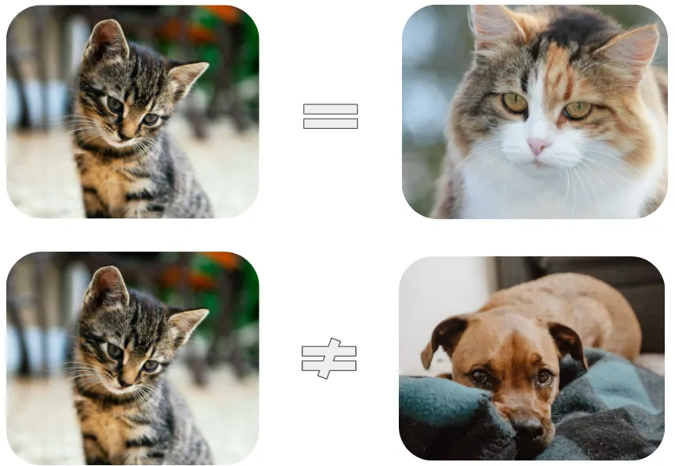
Contrastive learning
“Kitten” -> kitten_image -> “Cat”
“Cat” -> cat_image -> “Cat”
“Dog” -> dog_image -> “Not a cat”
Kitten is ‘an instance of’ cat, dog is ‘not an instance of’ cat In other words: Kitten has property ‘cat’, dog does not have property cat, so we want a model that can predict:
P(cat)[Kitten images] ~ high
P(cat)[Dog images] ~ low
https://towardsdatascience.com/understanding-contrastive-learning-d5b19fd96607

Slide 35
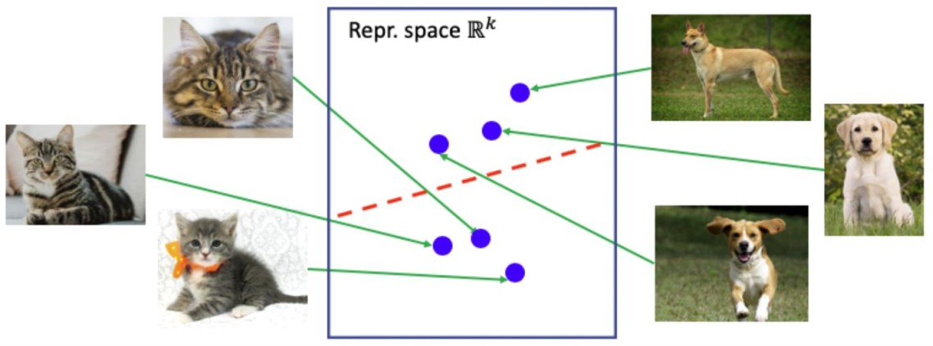
Latent data space / internal representation of observed data

Slide 36
Contrastive learning latent space (pre – training)
Positive (Kitten)
Anchor (Cat)
Negative (Dog)
Minimize the distance between Anchor and Positive (they share a property), minimize the distance between Anchor and Negative (they do not share a property).

Slide 37
Contrastive learning latent space (post – training)
Positive
Anchor
Negative

Slide 38
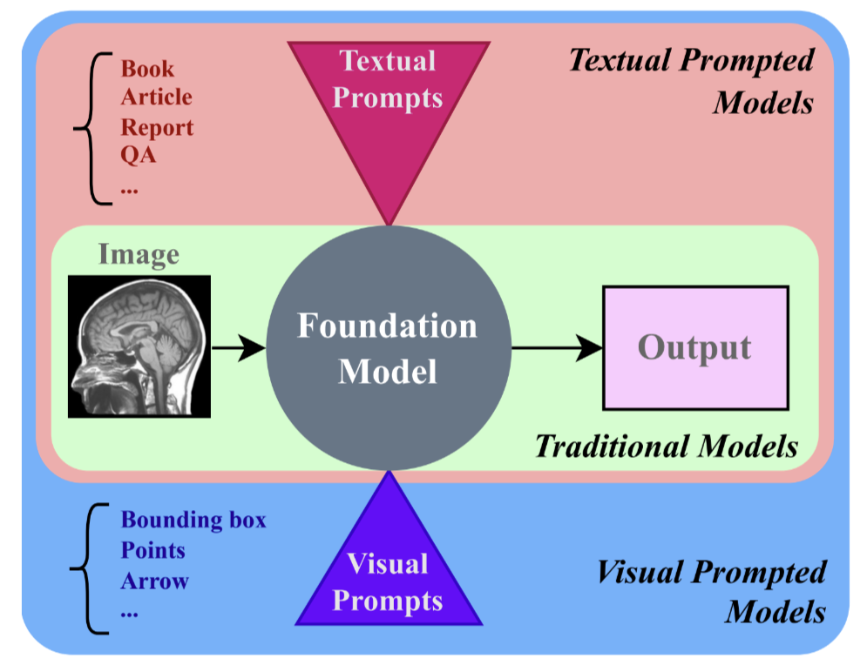
Apply contrastive learning to medical images
TPM; The learning objective is to minimize the gap between the representation of an image
and its corresponding text, while simultaneously increasing the separation between the representations of unrelated pairs. VPM; )", researchers have also explored Feature Maps (FMs)
that can be prompted by visual inputs (points, boxes, masks) which we refer to as “Visually Prompted Models (VPMs)"
[2] (see fig. 2 for a visual depiction of both). Recently, the Segment Anything (SA) model [10] has garnered significant
attention in the vision community. SAM is a promptable model developed for the purpose of broad image segmentation.
TPM
VPM
Azad et al., 2023; https://doi.org/10.48550/arXiv.2310.18689
Notes:
The learning objective is to minimize the gap between the representation of an image
and its corresponding text, while simultaneously increasing the separation between the representations of unrelated pairs.
In addition to this so-called “Textually Prompted Models (TPMs)", researchers have also explored Feature Maps (FMs)
that can be prompted by visual inputs (points, boxes, masks) which we refer to as “Visually Prompted Models (VPMs)"
[2] (see fig. 2 for a visual depiction of both). Recently, the Segment Anything (SA) model [10] has garnered significant
attention in the vision community. SAM is a promptable model developed for the purpose of broad image segmentation.

Slide 39
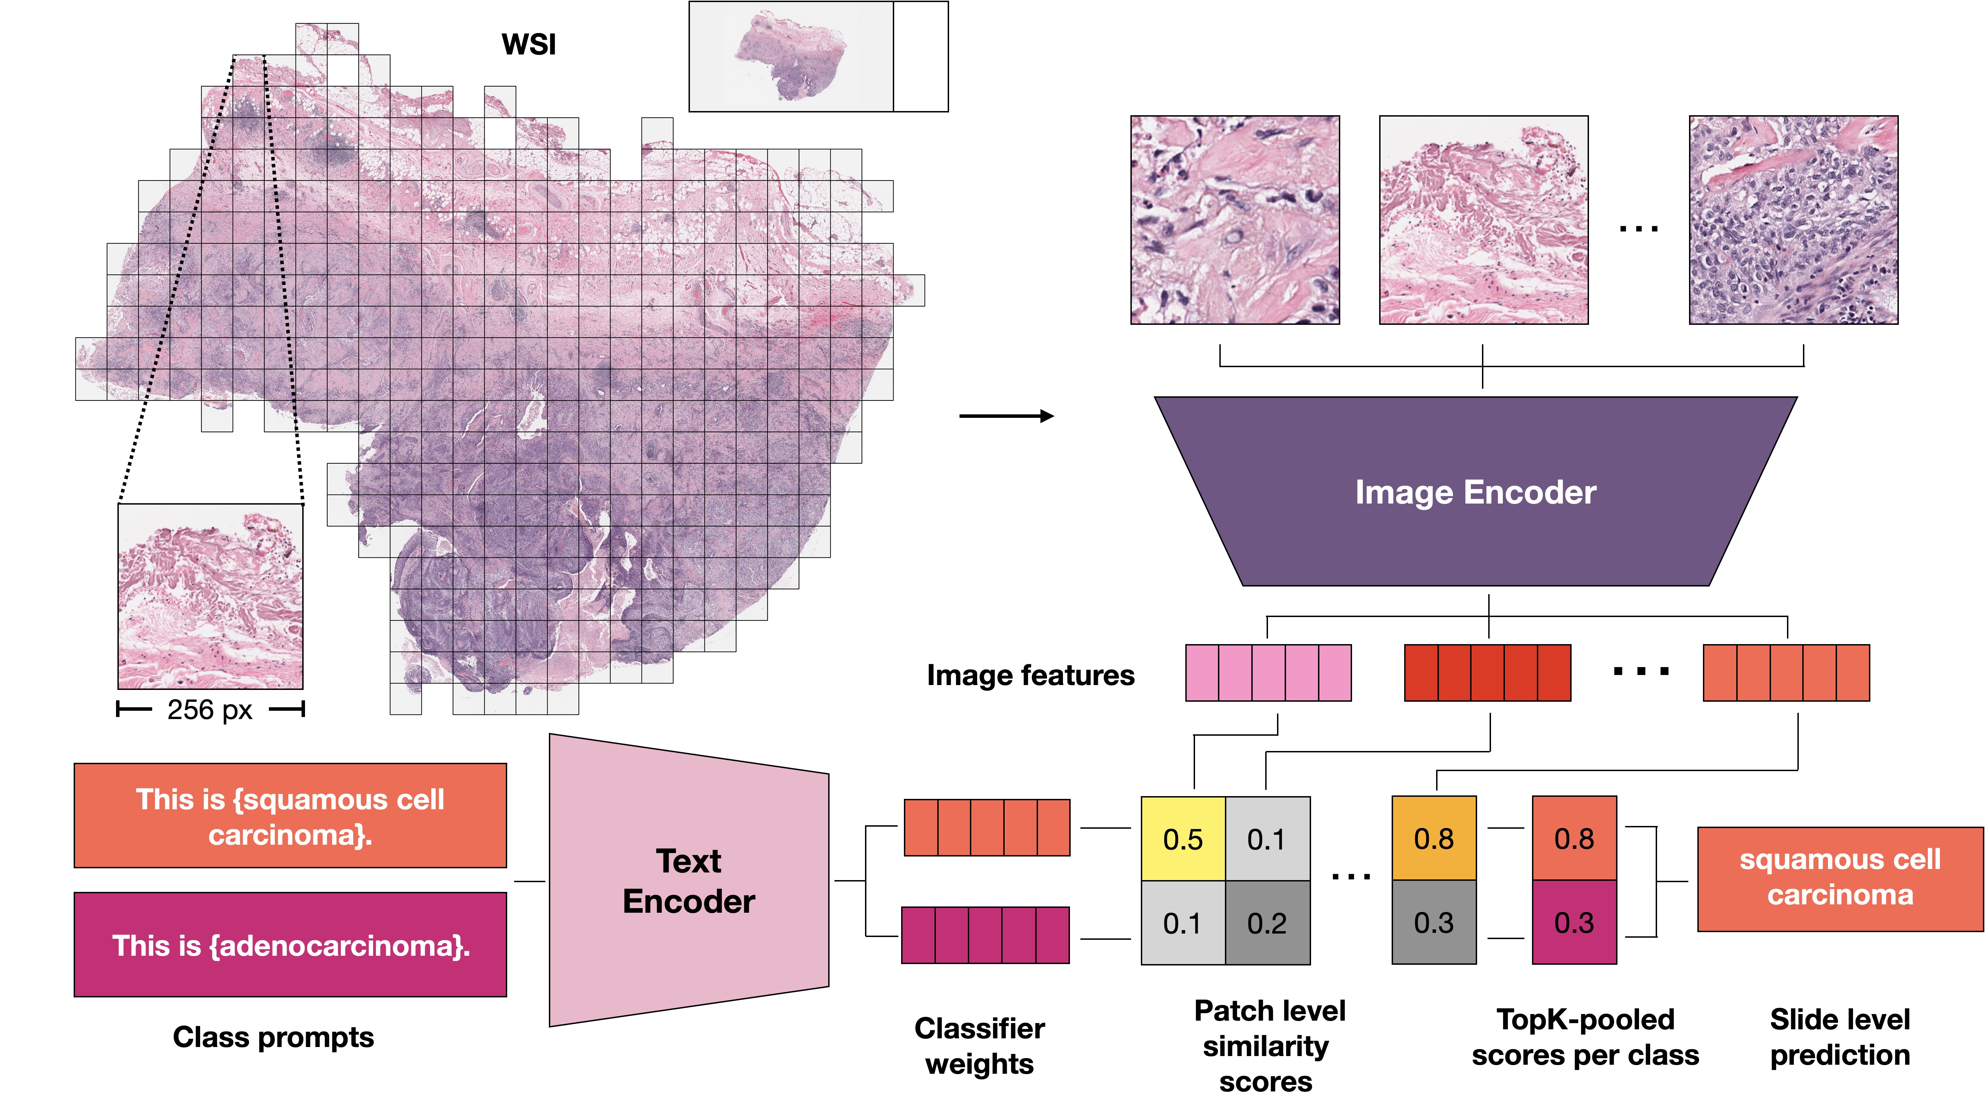
Medical Imaging (TPM) – histopathology
Ming Y Lu, Bowen Chen, Andrew Zhang, Drew FK Williamson, Richard J Chen, Tong Ding, Long Phi Le, Yung-Sung
Chuang, and Faisal Mahmood. Visual language pretrained multiple instance zero-shot transfer for histopathology
images. In Proceedings of the IEEE/CVF Conference on Computer Vision and Pattern Recognition, pages 19764–19775, 2023.
Azad et al., 2023; https://doi.org/10.48550/arXiv.2310.18689
Notes:
Schematic of MI-Zero [36]. A gigapixel WSI is transformed into a set of patches (instances), with each patch
being embedded into an aligned visual-language latent space. where the similarity scores between the embeddings of patches
and the embeddings of prompts are combined using a permutation-invariant operation like topK max-pooling to generate the
classification prediction at the WSI level.

Slide 40
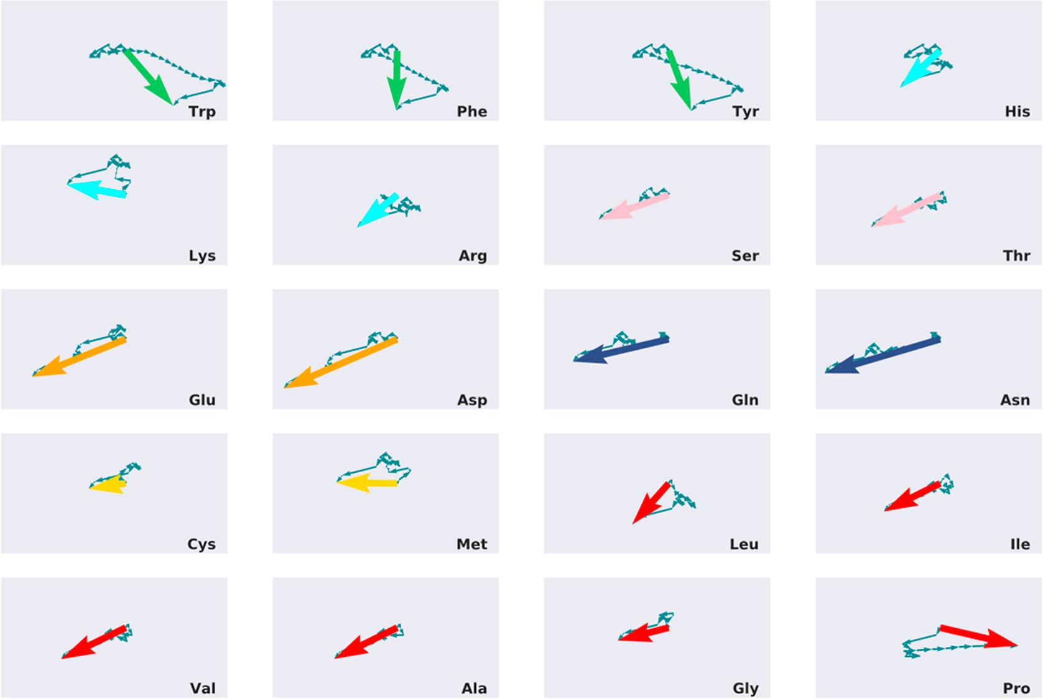
We can do the same for compounds

Slide 41
Conditional predictions from VAE model (output)
P(1)=0.92
P(2)=0.22
P(2)=0.12
input: InChI + properties of choice.
compound x
P(1)=0.32
P(2)=0.22
P(2)=0.82
compound y
properties

Slide 42
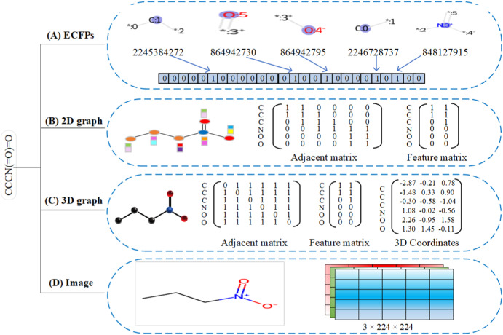
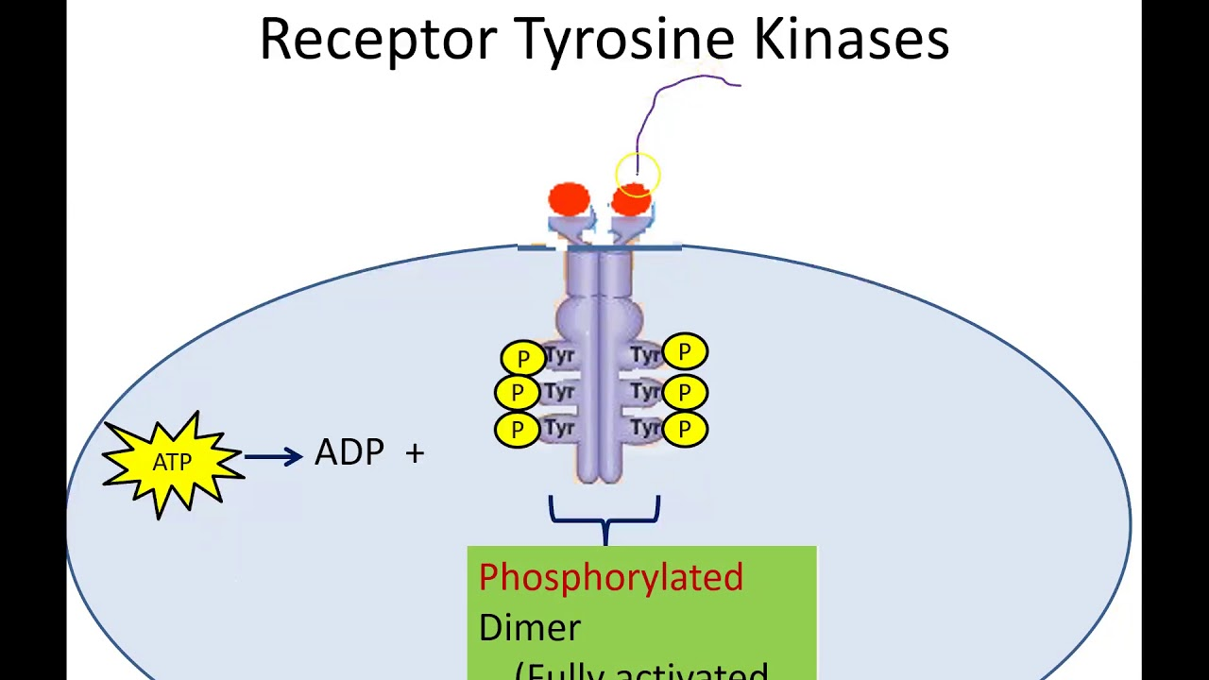
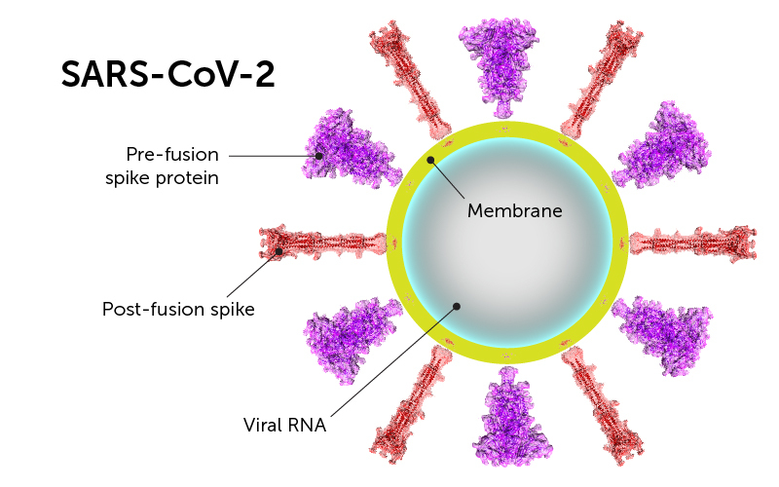
Predicting hazard based on structure; QSAR
?

Slide 43
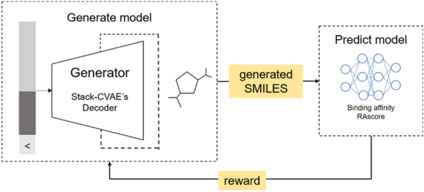
Conditional VAE; drug design
Kim, H., Ko, S., Kim, B. J., Ryu, S. J., & Ahn, J. (2022). Predicting chemical structure using reinforcement learning with a stack-augmented conditional variational autoencoder. Journal of cheminformatics, 14(1), 83. https://doi.org/10.1186/s13321-022-00666-9

Slide 44
QSAR – quatitative structure-activity relationships
Classic: Uses only structural information to predict ‘biological’ properties
Embedding structure based on substructures; sparsity
How to use exisiting ‘biological’ & ‘toxicological’ knowledge’?
→
Embed STRUCTURAL FEATURES + PROPERTIES

Slide 45
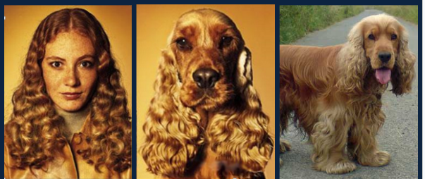
Biosim
Can we make a better similarity metric?
What is it good for?
Similarity is a respective measure. So let’s make property specific fingerprints.
Chemical discovery
Chemical clustering
Explainable predictions
Domain of Applicability
QSAR
Testing prioritization
Database Search
Notes:
The goal of this work was to create a better similarity metric with the intuition that similarity is a respective measure. The image demonstrates this intuition by asking which image is most similar to the center image? The woman and dog are most similar by pixel color, and the dogs are most similar by species. The same holds for chemicals, two chemical structures can be similar or dissimilar depending on the chemical property in question. This highlights the issue of activity cliffs with chemical embeddings that are not property specific.

Slide 46
Overview
Datasets
Knowledge Layer
Species
MeSH
Uberon
NCI Thesaurus
NCBI Taxonomy
HGNC
Protein Ontology
Biology
Evidence
PubMed
DSSTox Chemical Identifier
Evidence and Conclusion (ECO)
Environment (ENVO)
Exposure (ExO)
Environmental conditions, treatments and exposures (ECTO) httk
Anatomy
Methods (assay)
Genes
Exposure (e.g., route)
Proteins
Pathways
Chemical-Gene Interactions
Toxicology
Phenotypes
Testing Outcomes
toxicokinetics/dynamics
Chemical Identifier
PubChem
CAS
InChIKey
MeSH
QUDT
Chemoinformatics Ontology (CHEMINF)
SMILES
Quantities
Integration of 50+ Chemical Safety BioBricks aopwiki hgnc bindingdb cpdat lincs1000
ctdbase chembl tox21 toxcast mesh
ice pubchem cpcat openfda bioplanet
Structure
Chemistry
Reactions

Slide 47
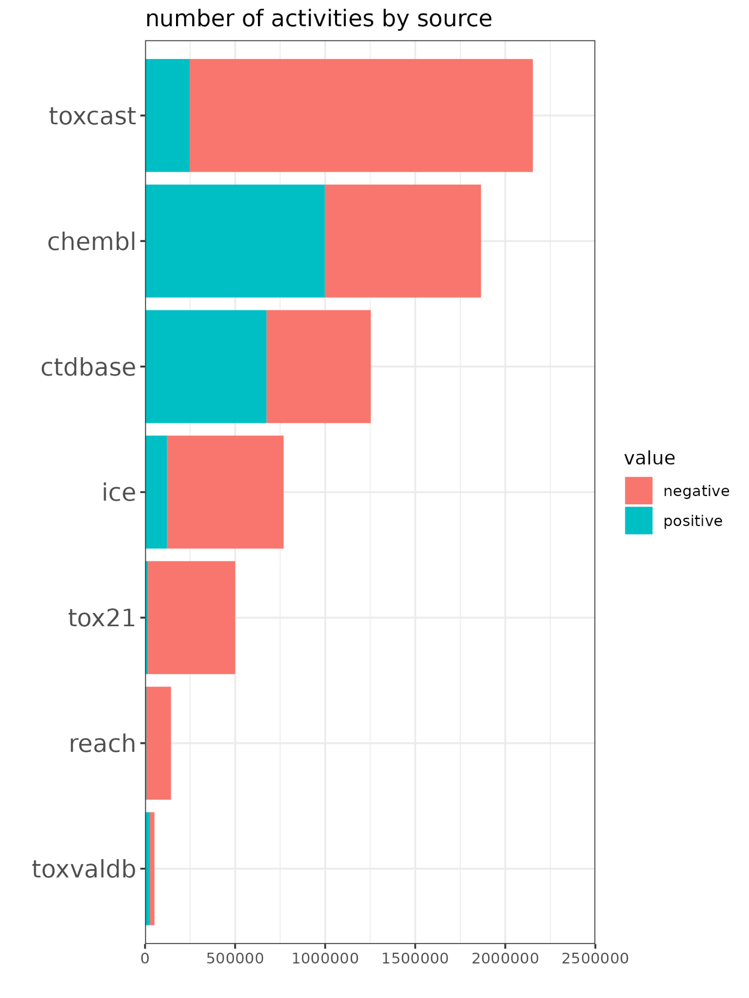
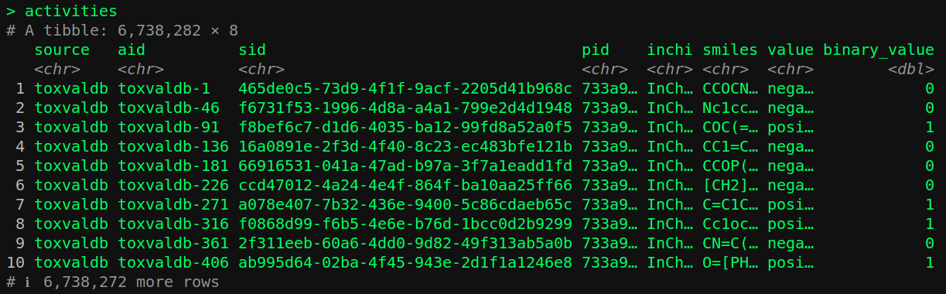
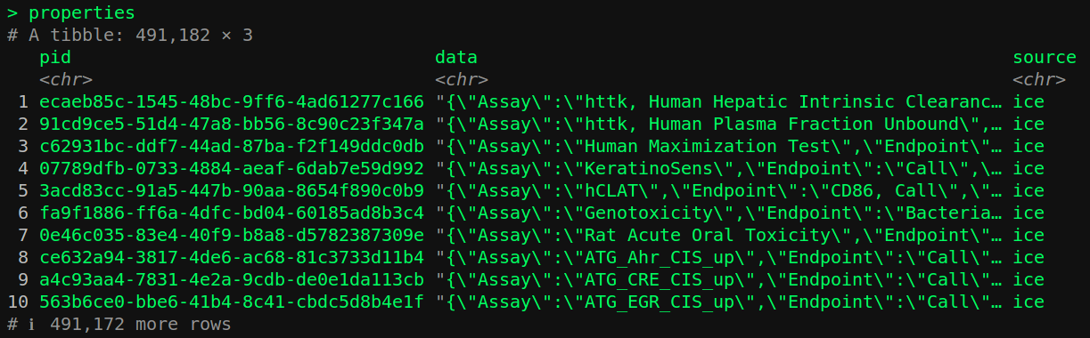
ChemHarmony
Each source is reduced to unique boolean activities
Property `pid` and substance `sid` tables store metadata
Now we are ready to build some models…
Notes:
Chemharmony combines 12 different cheminformatics databases. It collects triples associating chemicals, properties and their respective values. An example might be <benzene, causes_cancer, true>. The version of chemharmony we used has 6.7 million of these triples, but the more recent version of chemharmony has more than 200 million triples. This data asset uses biobricks to manage data dependencies.

Slide 48
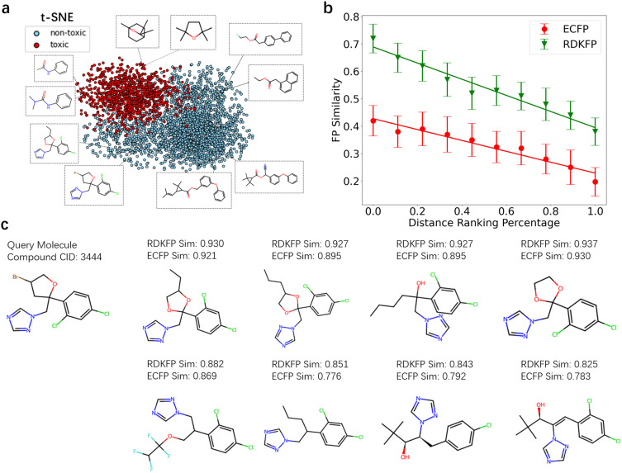
Contrastive learning for chemical safety
Ye Lin, Xin Yang, Mingxuan Zhang, Jinyan Cheng, Hai Lin, Qi Zhao, CLSSATP: Contrastive learning and self-supervised learning model for aquatic toxicity prediction, Aquatic Toxicology, Volume 279, 2025, 107244,
https://doi.org/10.1016/j.aquatox.2025.107244.

Slide 49
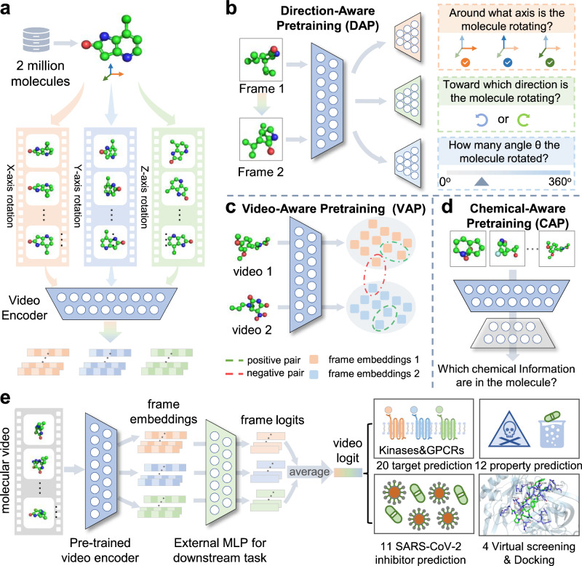
Molecular embeddings; beyond Morgan fingerprints
Xiang, H., Zeng, L., Hou, L., Li, K., Fu, Z., Qiu, Y., Nussinov, R., Hu, J., Rosen-Zvi, M., Zeng, X., & Cheng, F. (2024). A molecular video-derived foundation model for scientific drug discovery. Nature communications, 15(1), 9696. https://doi.org/10.1038/s41467-024-53742-z
Notes:
See this image and copyright information in PMC
Fig. 1. Overview of the VideoMol foundational model. a Feature extraction of molecular videos. First, we render 2 million molecules with conformers in 3D spatial structure. We then rotate the rendered molecule around the x
, y, z axes and generate snapshots for each frame of the molecule video. Finally, we feed the molecular frames into a video encoder to extract latent features. b–d Three self-supervised tasks for pre-training video encoder. The direction-aware pretraining (DAP) task is used to distinguish the relationship between pairs of molecular frames (such as the axis of rotation, the direction of rotation, and the angle of rotation) by using axis classifier (orange), rotation classifier (green) and angle classifier (blue). The video-aware pretraining (VAP) task is used to maximize intra-video similarity and minimize inter-video similarity. The chemical-aware pretraining (CAP) task is used to recognize information related to physicochemical structures in molecular videos by using chemical classifier (gray). e The finetuning of VideoMol on downstream benchmarks (such as binding activity prediction and molecular property prediction). A multi-layer perceptron (MLP) is added after the pre-trained video encoder for fine-tuning on four types of downstream drug discovery tasks (20 target prediction, 12 property prediction, 11 SARS-CoV-2 inhibitor prediction, and 4 virtual screening and docking). We assemble the results (logits) of each frame as the prediction result of molecular video (video logit). Xiang, H., Zeng, L., Hou, L., Li, K., Fu, Z., Qiu, Y., Nussinov, R., Hu, J., Rosen-Zvi, M., Zeng, X., & Cheng, F. (2024). A molecular video-derived foundation model for scientific drug discovery. Nature communications, 15(1), 9696. https://doi.org/10.1038/s41467-024-53742-z

Slide 50
Supporting AOP construction and evidence synthesis

Slide 51
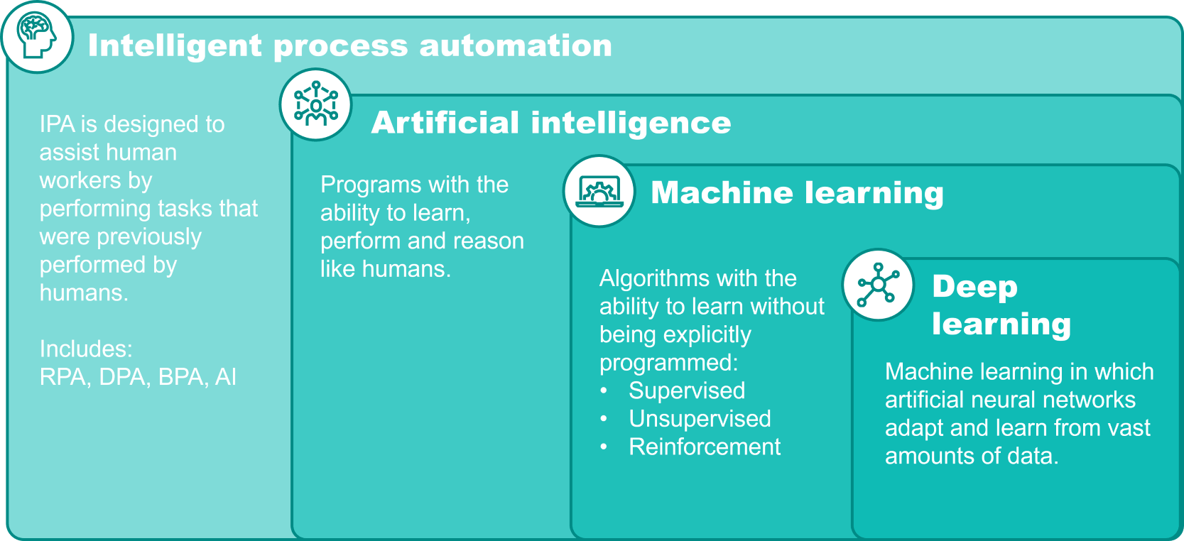
Artificial Intelligence; second conceptual pillar in ONTOX
Artificial intelligence (AI), in its broadest sense, is intelligence exhibited by machines, particularly computer systems. Wikipedia: https://en.wikipedia.org/wiki/Artificial_intelligence WP5 ONTOX Task “Create tools for mining data from unstructured data sources as input for the ONTOX ontology and the AI system”
IPA: Intelligent Process Automation
RPA: Robotic Process Automation
DPA: Digital Process Automation
BPA: Business Process Automation
AI: Artificial Intelligence
https://www.bakertilly.com/insights/the-ai-technology-landscape-explained

Slide 52
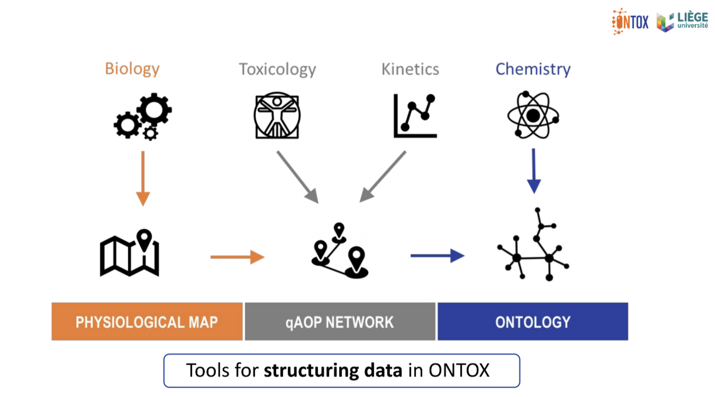
The ONTOX project; data collection
One conceptual pillar in the ONTOX project is the ontology, consisting of 4 critical domains for hazard prediction
For data integration, three tools are used: the physiological maps, (q)AOP networks and ontologies Data relies heavily on extraction from scientific literature
Vinken, M., Benfenati, E., Busquet, F., Castell, J., Clevert, D. A., de Kok, T. M., Dirven, H., Fritsche, E., Geris, L., Gozalbes, R., Hartung, T., Jennen, D., Jover, R., Kandarova, H., Kramer, N., Krul, C., Luechtefeld, T., Masereeuw, R., Roggen, E., Schaller, S., … Piersma, A. H. (2021). Safer chemicals using less animals: kick-off of the European ONTOX project. Toxicology, 458, 152846. https://doi.org/10.1016/j.tox.2021.152846

Slide 53
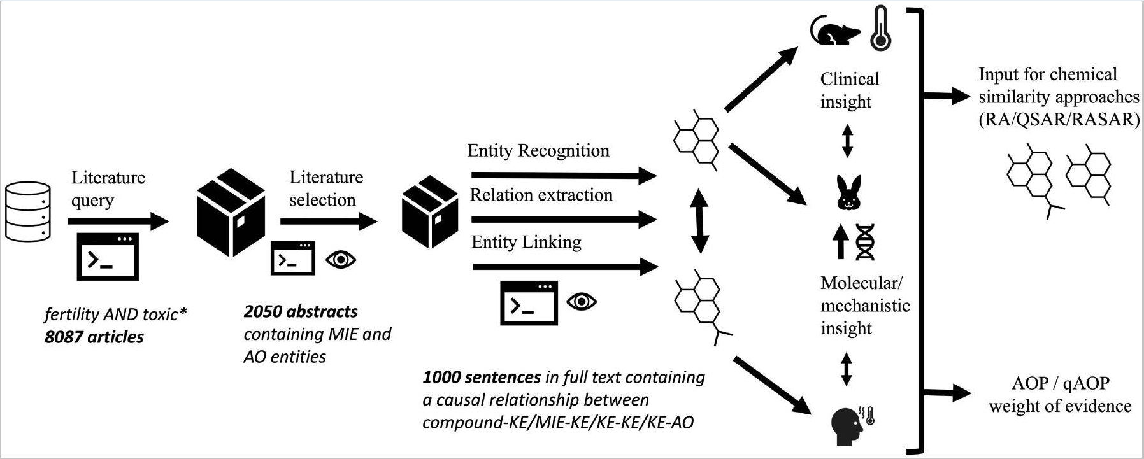
Intelligent process automation (IPA) for data extraction from literature
Extracted chemical/effect/event relationships are entered into graph database
Existing data (physiological maps / AOP can be used to scientifically validate
Refine, fine-tune or retrain the models can improve performance
read-accross
hazard
Corradi, M. P. F., de Haan, A. M., Staumont, B., Piersma, A. H., Geris, L., Pieters, R. H. H., Krul, C. A. M., & Teunis, M. A. T. (2022). Natural language processing in toxicology: Delineating adverse outcome pathways and guiding the application of new approach methodologies. Biomaterials and biosystems, 7, 100061. https://doi.org/10.1016/j.bbiosy.2022.100061

Slide 54
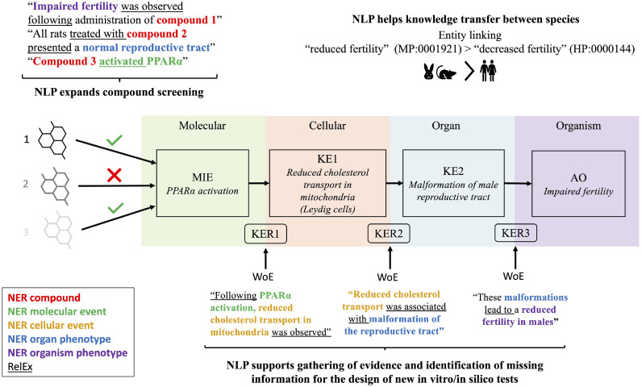
AI for information extraction; solving FAIR in Tox?
https://doi.org/10.1016/j.bbiosy.2022.100061

Slide 55
Case studies in this talk
en-tox: A natural language processing model for toxicological information extraction
Facilitating evidence review to build a kidney AOP with retrieval-augmented generation (RAG)
Building a disambiguated (graph) database of toxicological facts with LLMs

Slide 56
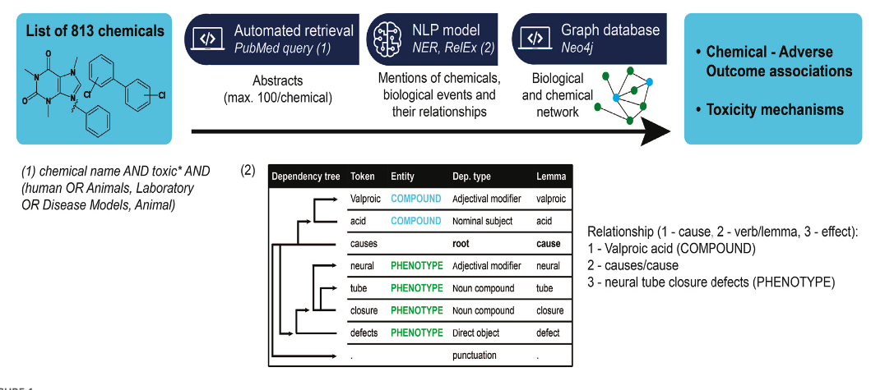


Case 1; Information extraction with en-tox spaCy model
https://github.com/ontox-project/en-tox
Corradi, M., Luechtefeld, T., de Haan, A. M., Pieters, R., Freedman, J. H., Vanhaecke, T., Vinken, M., & Teunis, M. (2024). The application of natural language processing for the extraction of mechanistic information in toxicology. Frontiers in toxicology, 6, 1393662. https://doi.org/10.3389/ftox.2024.1393662

Slide 57
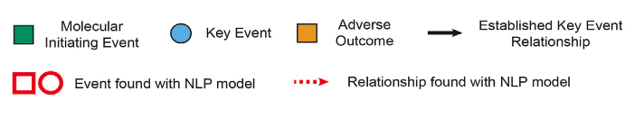
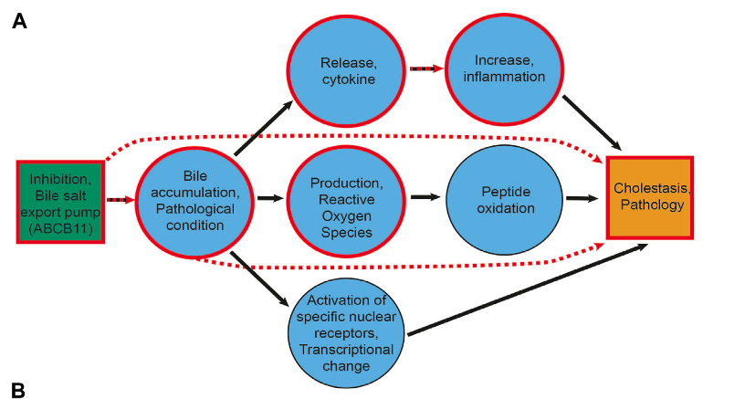
Reconstructing a liver AOP
Next steps: - disambiguation of terms
- entity linkage (e.g. to controlled vocabularies)
Corradi, M., Luechtefeld, T., de Haan, A. M., Pieters, R., Freedman, J. H., Vanhaecke, T., Vinken, M., & Teunis, M. (2024). The application of natural language processing for the extraction of mechanistic information in toxicology. Frontiers in toxicology, 6, 1393662. https://doi.org/10.3389/ftox.2024.1393662
Notes:
Many events were found. Relationships are still difficult.

Slide 58
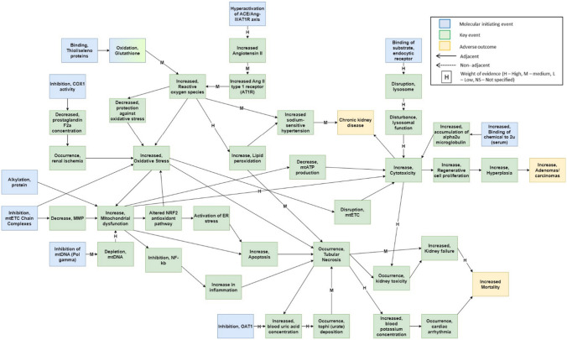
Case 2; Adding LLMs to the mix
Information retrieval for AOP building: a kidney adversity case study
Based on manually extracted and curated data
https://static-content.springer.com/esm/art%3A10.1007%2Fs00204-023-03637-7/MediaObjects/204_2023_3637_MOESM1_ESM.xlsx
Barnes, D. A., Firman, J. W., Belfield, S. J., Cronin, M. T. D., Vinken, M., Janssen, M. J., & Masereeuw, R. (2024). Development of an adverse outcome pathway network for nephrotoxicity. Archives of toxicology, 98(3), 929–942. https://doi.org/10.1007/s00204-023-03637-7

Slide 59
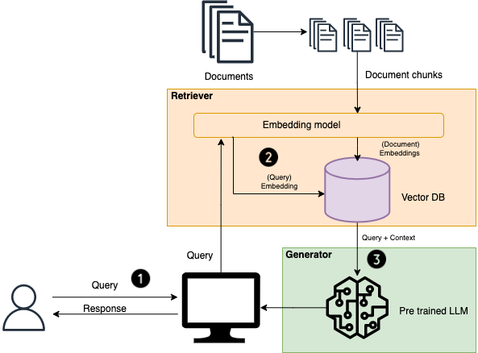
Retrieval-Augmented Generation (RAG)
RAG tries to mitigate:
Hallucinations
Knowledge Cutoff Limitations
Inaccurate or Outdated Responses
Contextual Irrelevance
Limited Domain Knowledge
https://medium.com/@hari4om/word-embedding-d816f643140

Slide 60

Facilitating evidence review for AOP building with RAG
Retrieval
Multiple retrieval methods:
Embeddings:
General vs specialized (trained on biomedical text)
Contextual embeddings
Reranking: beyond similarity, evaluate relevance of text to question with an LLM
Contextual RAG
GraphRAG
Generate answer to question using best matches*
Article database [Vector store]
+
Researcher’s question
LLM
Best matches in articles*
LLM
Potential for Weight of Evidence grading
* Point of view by domain expert
WoE potential; Which part of the information was most important for the generation of the answer?
Notes:
We focus on the retrieval part, not the generation part (yet).
When moving to generation, we could imagine using this to support rating weight of evidence: how much does each passage retrieved contribute to the final answer
This approach can be used to:
verifying that we can retrieve relevant information for AOP building with one of these methods
2) evaluating if one of the retrieval methods gives overall more relevant results (in its top 10)
It is becoming more and more known that LLMs are prone to hallucination. To remedy this issue, a technique has become popular: retrieval-augmented generation.
Then explain the principle of RAG, that an answer is generated to a user question using context retrieved from provided documents (in our case scientific articles). To retrieve relevant information for the LLM to use in its answer, the user question and the documents (broken into chunks of text) are embedded (= represented as matrices of numbers). The similarity between the question and the piece of text is then taken as an indicator of the relevance of the text.
Of course, this is the basic version, hence why some more sophisticated retrieval methods have been added (see reranking, etc.). We can also wonder whether embedding models trained on biomedical text do a better job than those trained on a more general corpus ("The Internet").
We are interested in a first phase in the retrieval and whether this is helpful for scientists to retrieve and review text that can support AOP key events (relationships).
A potential future step is to then generate an answer based on the text retrieved, and establish a grading system for the evidence used to formulate that answer, that could perhaps simulate weight of evidence assessment
Does this help?

Slide 61



Evaluating retrieval performance with experts
Question from researcher
Retrieved text
Relevance judgment
https://prodi.gy/
Notes:
Here we would probably rate relevant

Slide 62


Case 3; Building a graph database of toxicological facts with LLMs
Information retrieval, using (Graph)RAG
https://github.com/microsoft/graphrag
Toro S, Anagnostopoulos AV, Bello SM, Blumberg K, Cameron R, Carmody L, Diehl AD, Dooley DM, Duncan WD, Fey P, Gaudet P, Harris NL, Joachimiak MP, Kiani L, Lubiana T, Munoz-Torres MC, O'Neil S, Osumi-Sutherland D, Puig-Barbe A, Reese JT, Reiser L, Robb SM, Ruemping T, Seager J, Sid E, Stefancsik R, Weber M, Wood V, Haendel MA, Mungall CJ. Dynamic Retrieval Augmented Generation of Ontologies using Artificial Intelligence (DRAGON-AI). J Biomed Semantics. 2024 Oct 17;15(1):19. doi: 10.1186/s13326-024-00320-3. PMID: 39415214; PMCID: PMC11484368.

Slide 63

Pipeline; document processing, fact extraction and storage
Notes:
Import PDFs Papers can be imported in bulk, but text can also be manually entered into an input field.
Text Preprocessing PDFs are converted to plain text, references are removed from the text, and extra spaces and extracted words are cleaned up as much as possible. Abbreviations that are attached to words are separated as accurately as possible, and markdown elements are removed.
Text Sectioning LLMs have a limited context window, making it impossible to process entire texts effectively. To address this, the text is divided into sections (Abstract, Introduction, Methods, Results, Discussion) where possible. If these headings are missing, the text is split into paragraphs as accurately as possible.
LLM Structured Fact Extraction For each document and its sections, toxicology facts are extracted in JSON format, structured as follows: (Biomedical fact, additional details, summary/supporting text from the article). Since each section doesn't represent the full context, an additional step is taken.
LLM Refinement For each document, all JSON facts are combined, and toxicology facts are merged and refined while preserving the core information.
Database All results are stored in a database, including those from the previous step. It is essential to verify the model's results to ensure accuracy and prevent hallucinations.
Manual Review To prevent incorrect facts from being perceived as valid, experts can review these results. Once a fact is approved, the knowledge base for ontologies is updated accordingly.
Ontology Knowledge Base To automatically verify facts, they need to be based on a solid foundation. A knowledge base is built using online datasets and other sources.
Automatic Verification Facts can be automatically verified, and the database logs whether verification was performed manually or by a computer. It is recommended to present this information to the user for transparency.
Graph Database Finally, the facts are transformed and stored in a graph database for future use!

Slide 64

Bulk Processing of PDFs (Flask GUI)
LLM Fact Extraction for all sections of every document

Slide 65

Example Extracted Fact
Next steps:
Add additional metadata,
Review by experts,
Add to GraphDB,
Experiment with (Graph)RAG

Slide 66
Things move fast

Slide 67
New models are here, every day
OpenAI – o3, 4o → 4.5 with possible AGI characteristics
GPT-4o is available!
Meta - Llama 3.3 – open source
Anthropic – Claude Sonnet 3.7
Google – Gemini 2.0 flash
{Video 11 December, 2024}

Slide 68


Slide 69
Discuss with your neighbour
What would Gemini 2.0 access mean for you; your job, your life?
Think of 2 use cases for chemical hazard assessment, discuss them
We take 5 minutes to discuss this, than I will ask some duos to share their thoughts

Slide 70
AI dilemmas

Slide 71

AI Energy consumption
http://dx.doi.org/10.3389/fnins.2019.00666

Slide 72

DeepSeek R1; a new model
DeepSeek R1 is about 95% ‘cheaper’ than
OpenAI o1. In terms of traning cost and is running at
at lower energy demand.

Slide 73

AI impacting the economy
20/01/2025, DeepSeek Release

Slide 74

The search for reducing cost and energy consumption
Alternative architectures
Alternative hardware
Alternative algorithms

Slide 75

DeepSeek; Less energy & cheaper – but with sensorship
Why Is China criticized for human rights abuses with the Uyghurs?
What is Taiwan's status with China?
What happened at Tiananmen Square in 1989?
What are the biggest criticisms of Xi Jinping? and
How does censorship work in China?
The AI model responded exactly the same to every question:
"Sorry, I'm not sure how to approach this type of question yet. Let's chat about math, coding, and logic problems instead!"
https://medium.datadriveninvestor.com/the-chinese-obliterated-openai-a-side-by-side-comparison-of-deepseek-r1-vs-openai-o1-for-finance-93a1b4343a82
https://www.forbes.com/sites/maryroeloffs/2025/01/27/does-deepseek-censor-its-answers-we-asked-5-questions-on-sensitive-china-topics/

Slide 76
Open source vs. Closed source; advantages
1. Transparency: Full visibility into the models’ architecture and training data encourages trust and enables thorough evaluation.
2. Community Contributions: Contributions from a global community of developers can enhance the model’s capabilities and address issues like biases or bugs.
3. Customization: Users can tailor the model to specific needs, whether for niche applications or improved performance in particular contexts.
4. Cost: Open-source models are typically free to use, although there may be costs associated with computing resources and infrastructure.
1. Professional Support: Closed-source models often come with dedicated support teams, regular updates, and maintenance services.
2. Performance and Optimization: Companies behind closed-source models can leverage extensive resources to fine-tune performance and efficiency.
3. Ease of Use: Closed-source models typically offer user-friendly APIs and integration tools, streamlining implementation.
https://medium.com/@sangitapokhrel911/open-source-and-closed-source-llms-a-detailed-comparison-58d3107722e8

Slide 77
Open source vs. Closed source; challenges
1. Maintenance: Open-source models may lack the consistent support and updates provided by commercial entities, depending on community engagement.
2. Performance Variability: The quality of open-source models can vary, and advanced optimization may not always be available.
1. Cost: Licensing fees or subscription costs can be substantial, depending on usage and model capabilities.
2. Limited Transparency: Users have less insight into the model’s inner workings, which can impact trust and understanding.
3. Less Customization: Customizing closed-source models is generally limited compared to open-source alternatives.
https://medium.com/@sangitapokhrel911/open-source-and-closed-source-llms-a-detailed-comparison-58d3107722e8

